Slide 1
CS7/8745 : Machine Learning Instructor: Salim Sazzed Department of Computer Science University of Memphis

Slide 2
What is Logistic Regression?
Logistic regression is a classification algorithm used to examine relationships between independent variables (predictors) and a dependant variable (criterion)
The main difference is in logistic regression, the target is nominal (predicting group membership). For example, do age and gender predict whether one signs up for swimming lessons (yes/no)
Its actually not regression, rather classification…
https://careerfoundry.com/en/blog/data-analytics/what-is-logistic-regression/

Slide 3
Types of Logistic Regression
There are primarily 2 types of logistic regression: (1) Binary and (2) Multinomial models. The difference lies in the types of the criterion variable
Binary logistic regression is for a dichotomous criterion (i.e., 2-level variable)
Multinomial logistic regression is for a multicategorical criterion (i.e., a target variable with more than 2 levels)

Slide 4
For binary regression, we calculate the conditional probability of the dependent variable Y, given independent variable X
It can be written as P(Y=1|X) or P(Y=0|X)
This is read as the conditional probability of Y=1, given X or conditional probability of Y=0, given X.

Slide 5
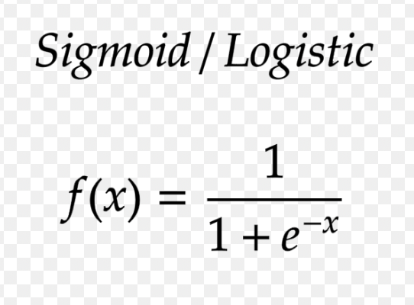
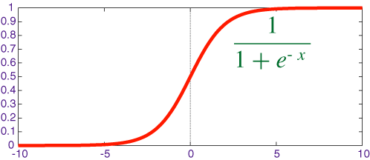
Sigmoid Function:
The sigmoid function is used to model the probability of an example belonging to a particular class. It's a fundamental part of logistic regression.
The sigmoid function takes the linear combination of features and weights and maps it to a probability value between 0 and 1.

Slide 6
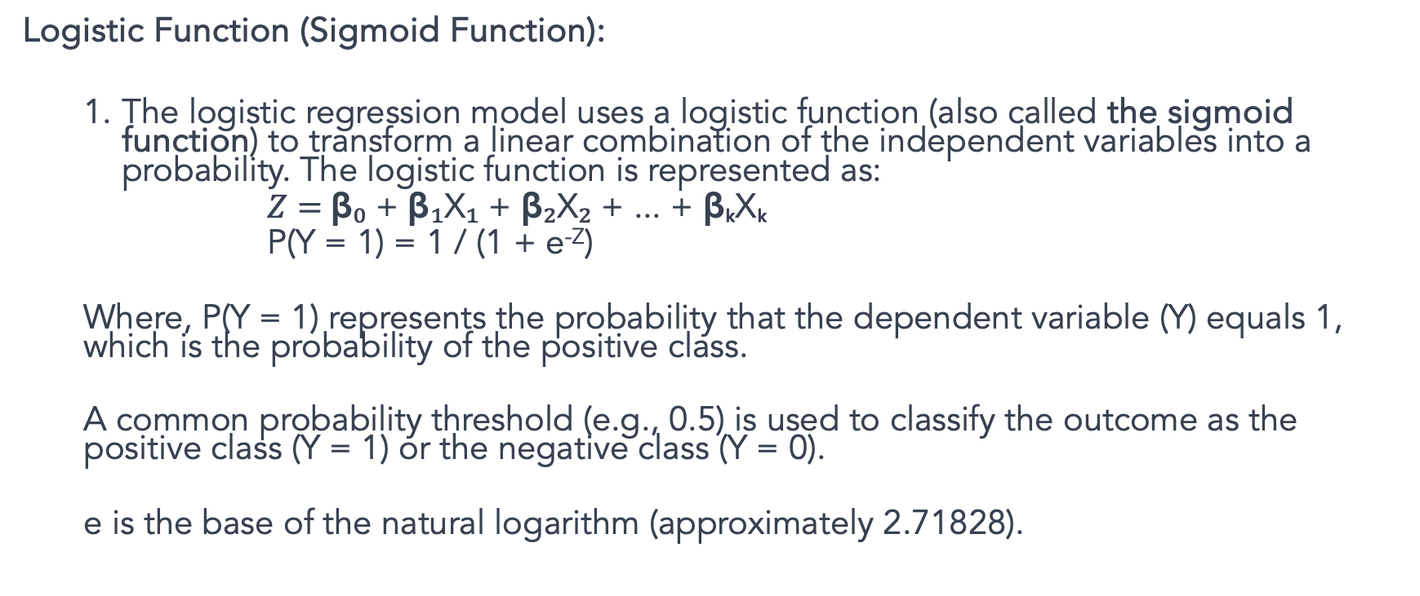
P(Y |X) is approximated as a sigmoid function applied to a linear combination of input features
Logistic Function (Sigmoid Function):
The logistic regression model uses a logistic function (also called the sigmoid function) to transform a linear combination of the independent variables into a probability. The logistic function is represented as:
$Z=$β₀ + β₁X₁ + β₂X₂ + ... + βₖXₖ
P(Y = 1) = 1 / (1 + e^{-Z})
Where, P(Y = 1) represents the probability that the dependent variable (Y) equals 1, which is the probability of the positive class.
A common probability threshold (e.g., 0.5) is used to classify the outcome as the positive class (Y = 1) or the negative class (Y = 0).
e is the base of the natural logarithm (approximately 2.71828).

Slide 7
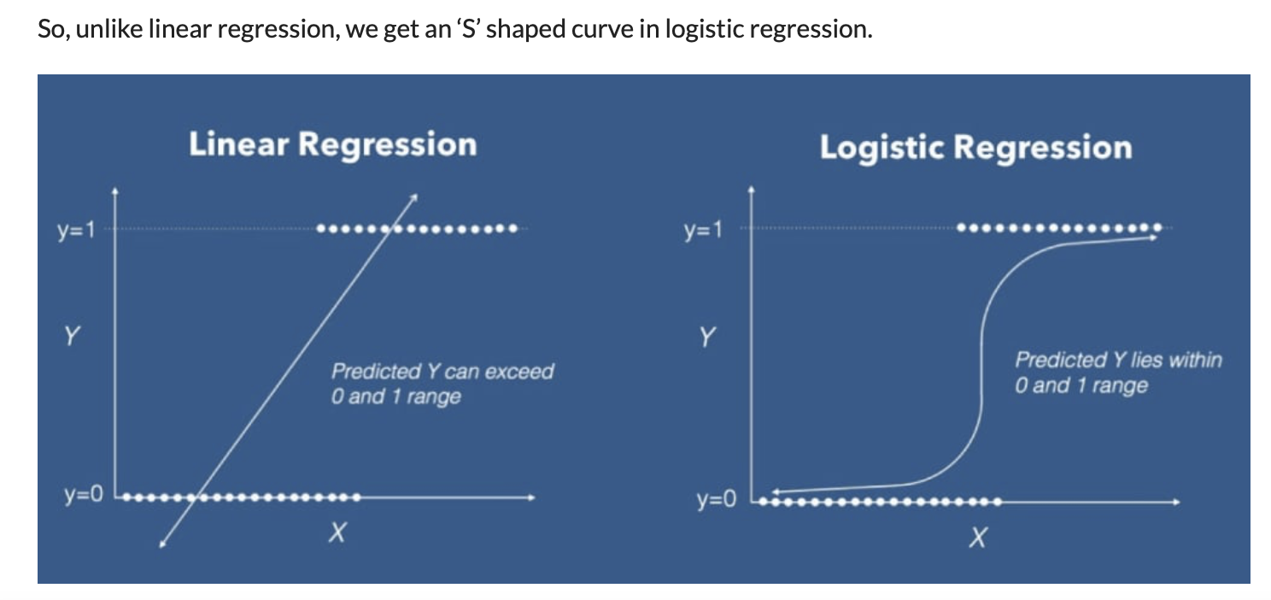

Slide 8
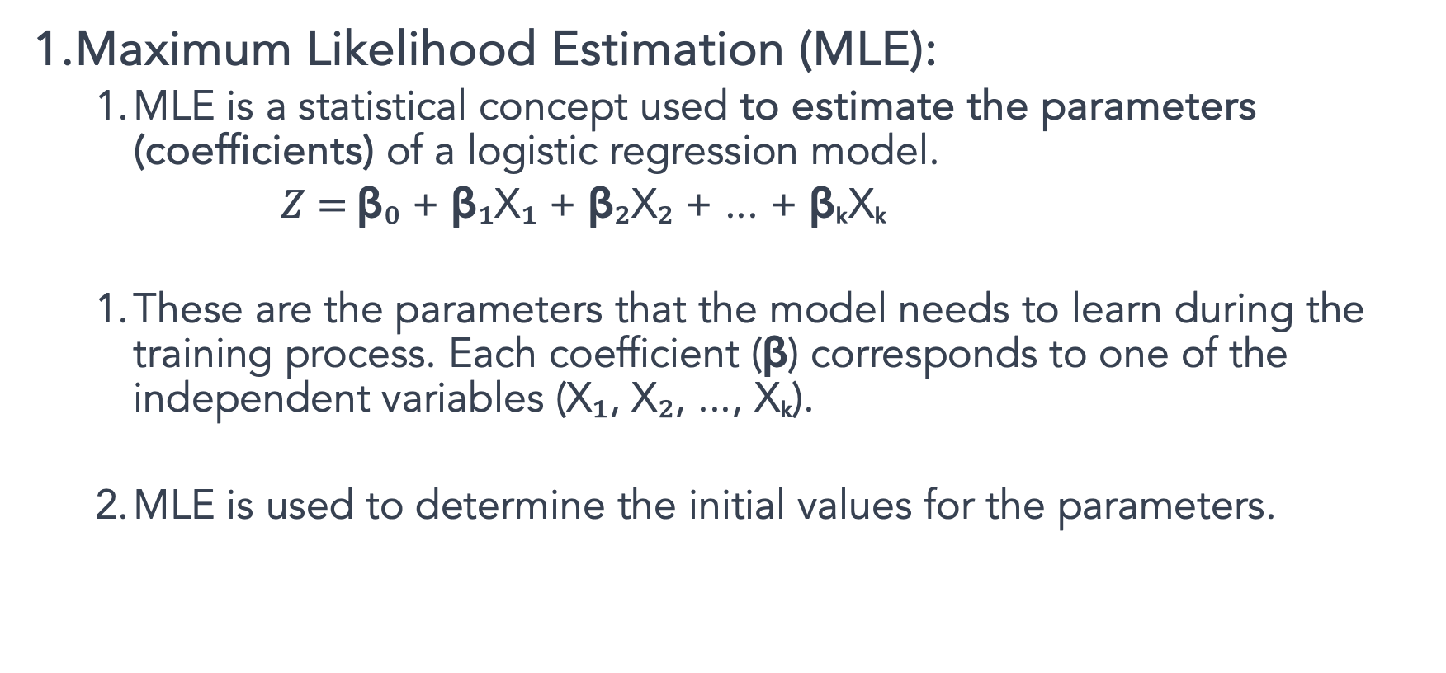
Maximum Likelihood Estimation (MLE):
MLE is a statistical concept used to estimate the parameters (coefficients) of a logistic regression model.
$Z=$β₀ + β₁X₁ + β₂X₂ + ... + βₖXₖ
These are the parameters that the model needs to learn during the training process. Each coefficient (β) corresponds to one of the independent variables (X₁, X₂, ..., Xₖ).
MLE is used to determine the initial values for the parameters.

Slide 9
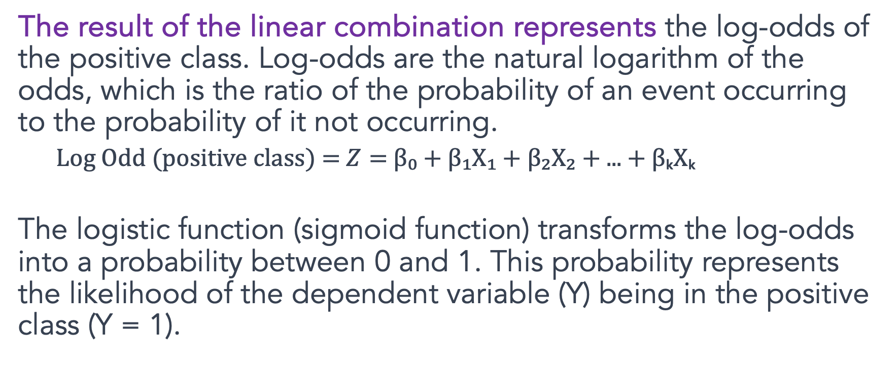
Log Odd
The result of the linear combination represents the log-odds of the positive class. Log-odds are the natural logarithm of the odds, which is the ratio of the probability of an event occurring to the probability of it not occurring.
Log Odd (positive class) = $Z=$β₀ + β₁X₁ + β₂X₂ + ... + βₖXₖ
The logistic function (sigmoid function) transforms the log-odds into a probability between 0 and 1. This probability represents the likelihood of the dependent variable (Y) being in the positive class (Y = 1).

Slide 10
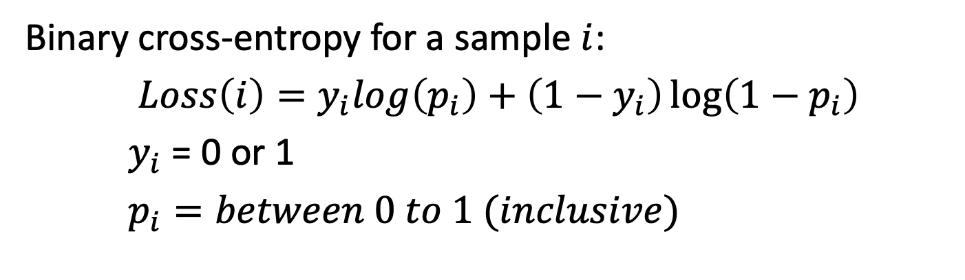
Cross-Entropy (Log Loss):
Cross-entropy, also known as log loss, is the loss function used in logistic regression.
It quantifies how well the predicted probabilities from the sigmoid function match the true class labels in the training data.
Cross-entropy is the function that needs to be minimized during training.
Binary cross-entropy for a sample $i$:
$Loss\left(i\right)=y_{i}log\left(p_{i}\right)+\left(1−y_{i}\right)\log\left(1−p_{i}\right)$
$y_{i}$ = 0 or 1
$p_{i}=between 0 to 1 (inclusive)$

Slide 11
Gradient Descent:
Gradient Descent is the optimization algorithm used to adjust the model's parameters (Coefficients) to minimize the cross-entropy loss.
It calculates the gradients of the loss with respect to the parameters (coefficients) and updates the parameters ((coefficients) ) iteratively in the direction that reduces the loss.

Slide 12
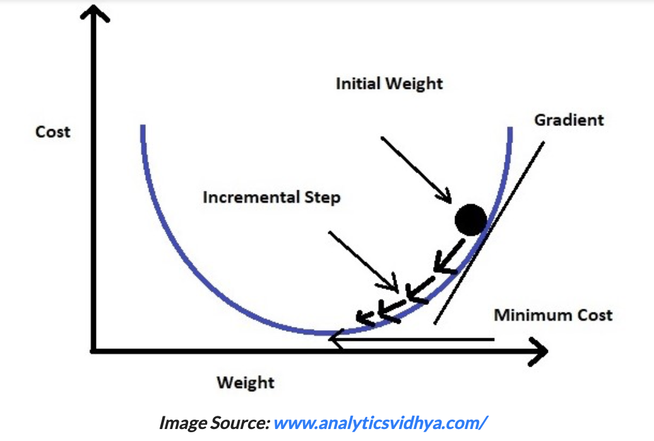
The intuition is that if you are hiking in a canyon and trying to descend most quickly down to the river at the bottom, you might look around yourself 360 degrees, find the direction where the ground is sloping the steepest, and walk downhill in that direction.

Slide 13

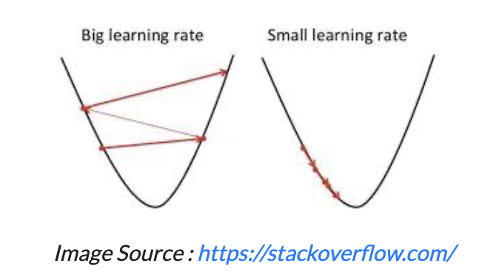
Gradient descent changes the value of our coefficients in such a way that it always converges to minimum point or we can also say that, it aims at finding the optimal weights which minimize the loss function of our model.
It is an iterative method that finds the minimum of a function by figuring out the slope at a random point and then moving in the opposite direction.
https://www.analyticsvidhya.com/blog/2021/08/conceptual-understanding-of-logistic-regression-for-data-science-beginners/

Slide 14
Model training in logistic regression involves estimating the coefficients (β₀, β₁, β₂, ...) of the model that best fit the observed data.
This is typically done using a process called maximum likelihood estimation. Here's how model training in logistic regression is performed:
Initialization:
Start with initial guesses or values for the coefficients (β₀, β₁, β₂, ...). Often, these initial values are set to 0 or random values.
Calculate Log-Odds:
Use the current coefficient values to calculate the log-odds for each data point in your training dataset. The log-odds for a single data point (i) can be calculated as:
Log-Odds(i) = β₀ + β₁X₁(i) + β₂X₂(i) + ... + βₖXₖ(i)
This calculates the log-odds of the positive class for each data point.
Apply the Logistic (Sigmoid) Function:
Apply the logistic function (sigmoid function) to the calculated log-odds to obtain predicted probabilities for each data point. The logistic function is:
P(Y(i) = 1) = 1 / (1 + e^(-Log-Odds(i)))
P(Y(i) = 1) represents the predicted probability that the data point i belongs to the positive class.

Slide 15
Compare Predictions to Actual Values:
Compare the predicted probabilities to the actual binary outcomes in your training dataset. Typically, you have values of 0 or 1 for each data point, where 1 indicates the positive class and 0 the negative class.
Calculate (Log)Likelihood/Cross-entropy:
Compute the likelihood of the observed data given the current model. The likelihood is a measure of how well the model fits the data and is calculated using the predicted probabilities and actual outcomes. The likelihood is a product of probabilities for all data points.
Update Coefficients:
Use optimization techniques like gradient descent or other optimization algorithms to adjust the coefficients in a way that increases the likelihood of the observed data. The goal is to find the set of coefficients that maximize the likelihood.

Slide 16
Repeat Iteratively:
Continue the process of calculating log-odds, applying the logistic function, comparing predictions to actual values, and updating the coefficients iteratively. This process is repeated until a convergence criterion is met, such as when the change in the likelihood becomes very small or after a predefined number of iterations.
Convergence and Final Coefficients:
Once the optimization process converges, you obtain the final values of the coefficients (β₀, β₁, β₂, ...). These coefficients represent the best-fit model that maximizes the likelihood of the observed data.
Model Training Complete:
The model training is complete when you have the final coefficients. You can now use these coefficients to make predictions on new data by calculating the log-odds and applying the logistic function.

Slide 17
Clustering

Slide 18
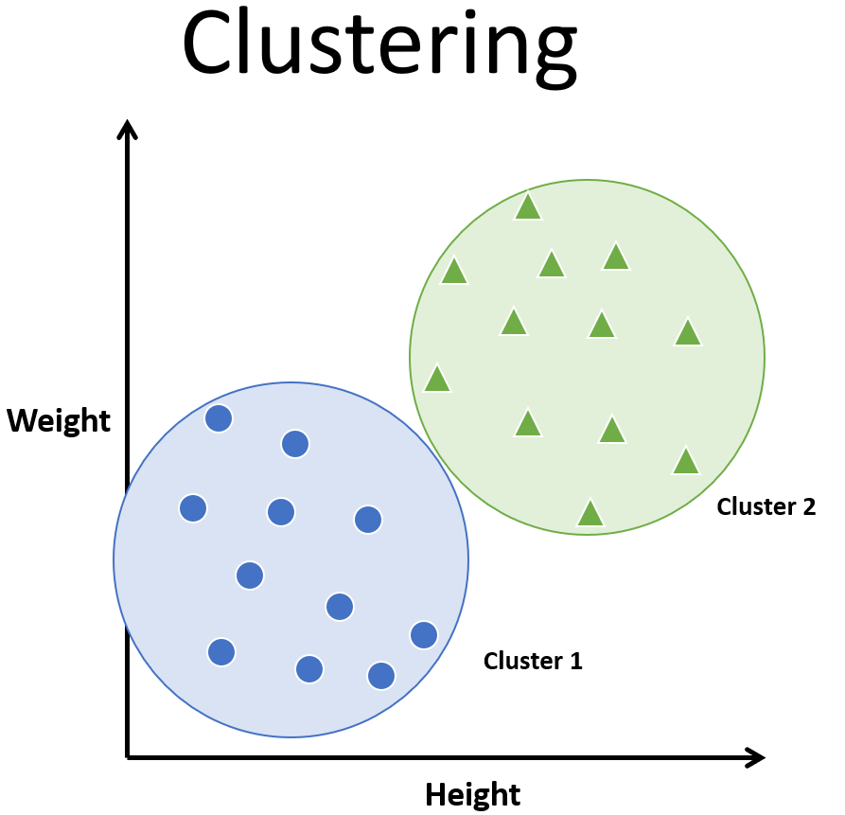
What is clustering?
The process of partitioning data into a set of meaningful sub-classes.
Purpose: Uncover natural grouping or structure
Multiple use cases
stand-alone tool to gain insight into data
preprocessing step for other algorithms
data compression
Outlier detection

Slide 19
What are clusters?
A subset of objects such that the distance between any two objects in the cluster is less than the distance between any object in the cluster and any object not located inside it.
A connected region of a multidimensional space containing a relatively high density of objects.

Slide 20
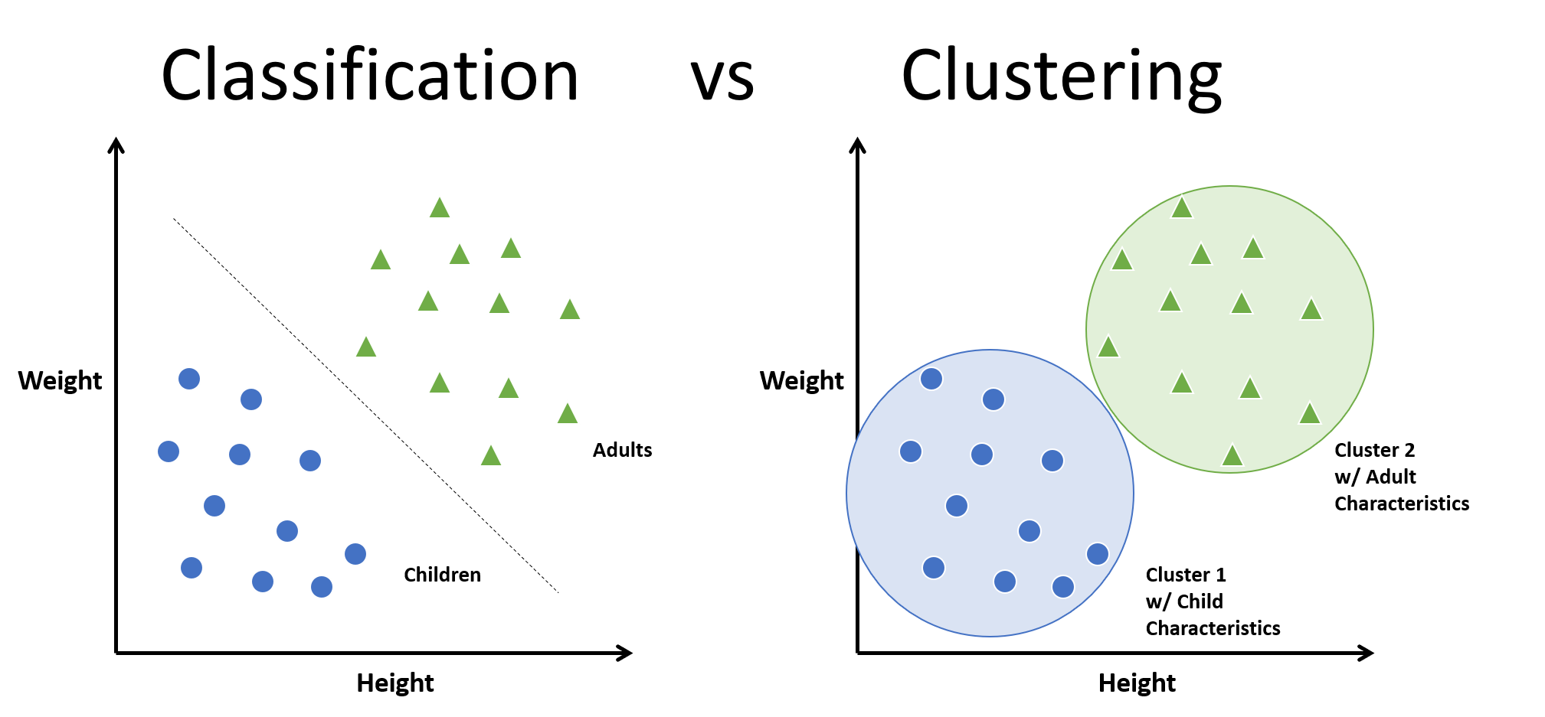

Slide 21
Clustering itself can be categorized into two types:
Hard Clustering and Soft Clustering.
In hard clustering, one data point can belong to one cluster only.
in soft clustering, the output provided is a probability likelihood of a data point belonging to each of the pre-defined numbers of clusters.

Slide 22
Unsupervised Clustering: K-means
K-means is an unsupervised machine learning algorithm used for clustering data, where it groups similar data points into K clusters based on their features.
K-value: The number of clusters (K) is a user-defined hyperparameter that you must specify before applying the algorithm. Determining the optimal K value can be a challenge.

Slide 23
Centroids: The algorithm uses centroids, which are points in feature space that represent the center of each cluster. Initially, these centroids are either randomly chosen or selected using a more sophisticated initialization method like K-means++.
Hard Clustering: K-means performs hard clustering, meaning each data point is assigned to exactly one cluster, represented by the nearest centroid.
Iterative Process:

Slide 24
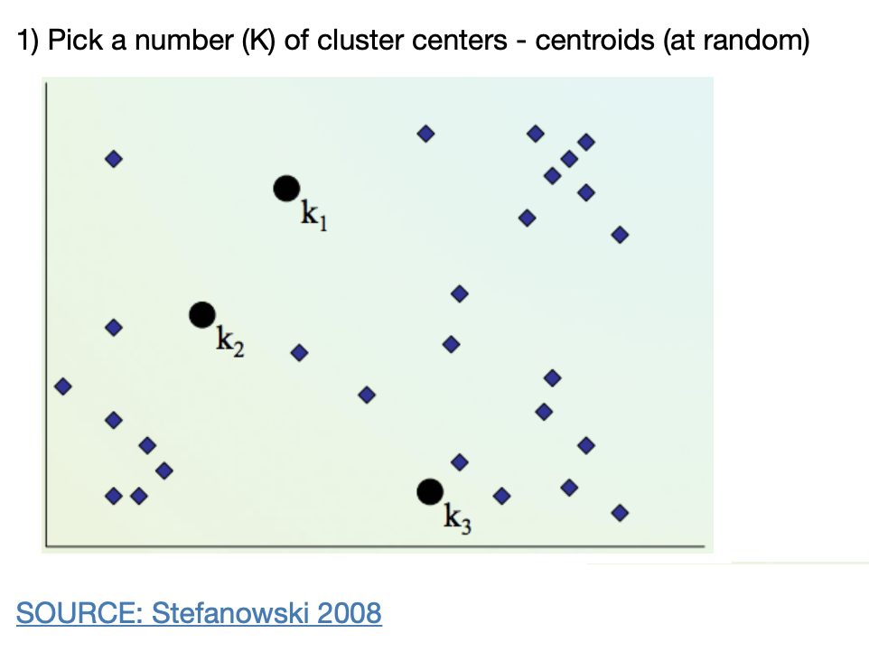
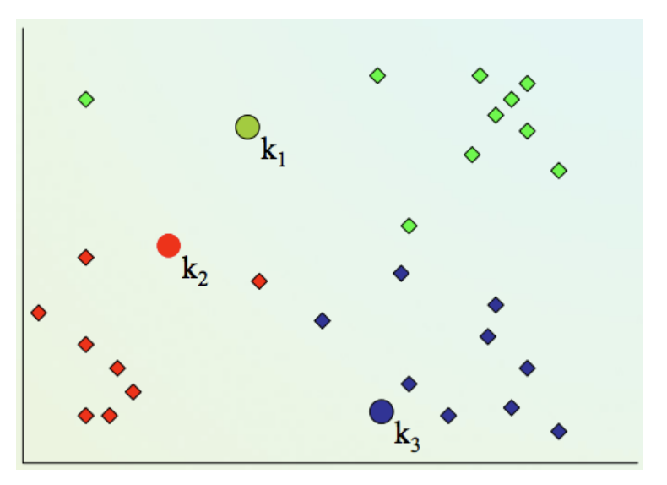
2) Assign every item to its nearest cluster center (e.g. using Euclidean distance)

Slide 25
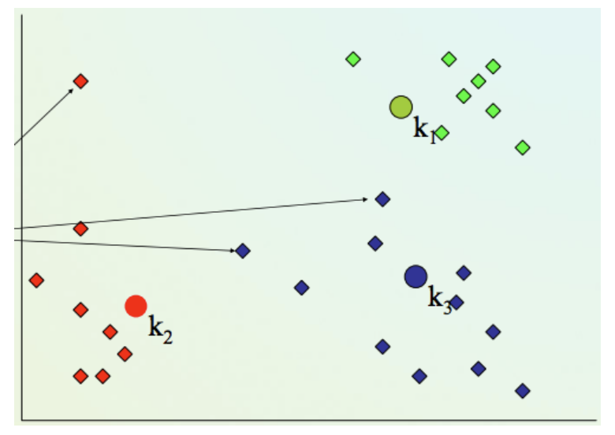
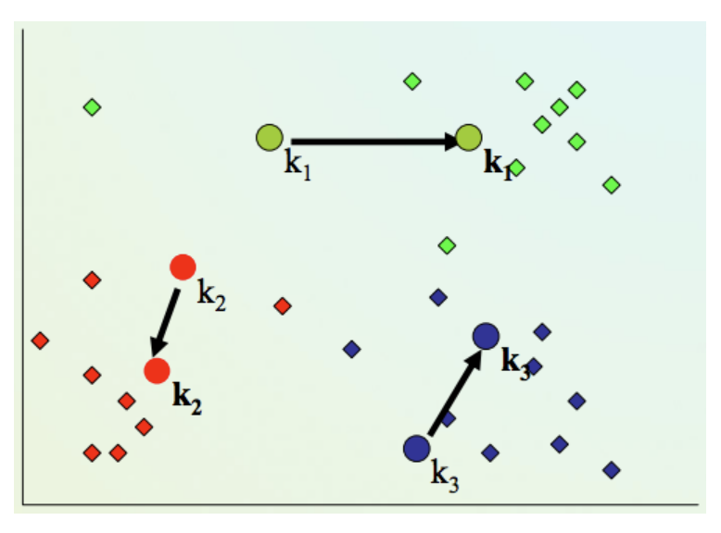
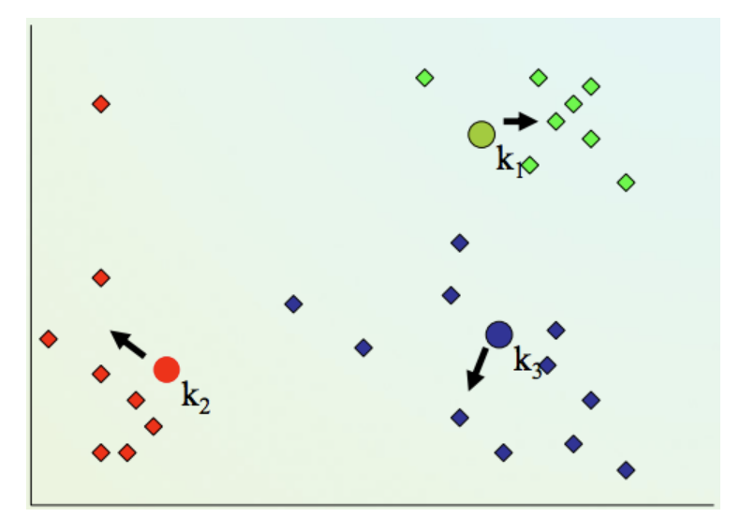
4) Repeat steps 2,3 until convergence (change in cluster assignments less than a threshold)
3. Move each cluster center to the mean of its assigned items

Slide 26
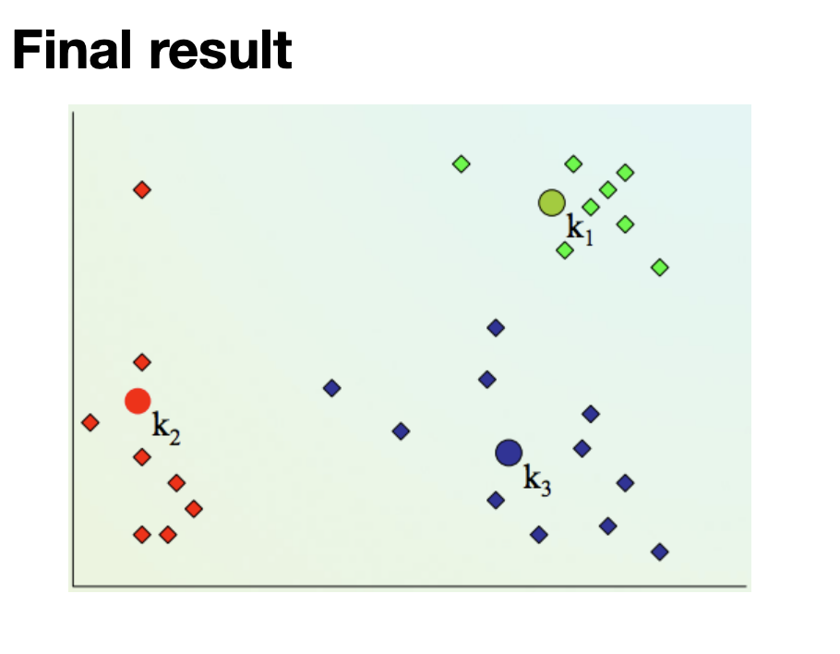

Slide 27
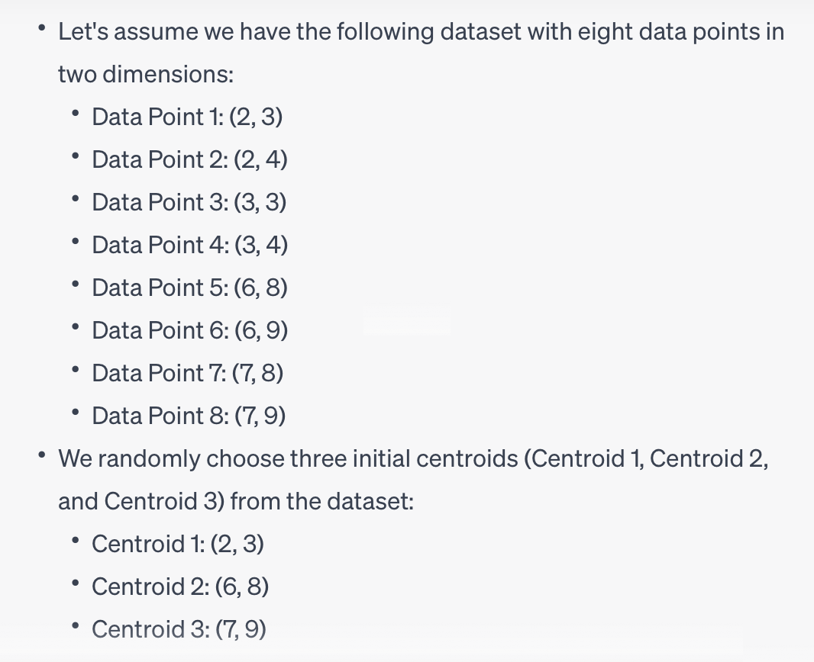

Slide 28
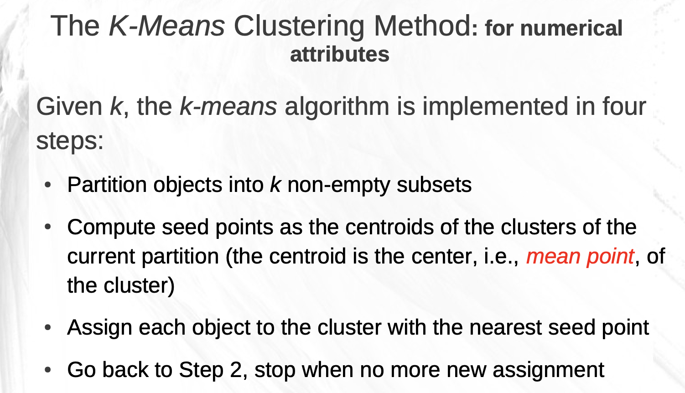
https://csc.csudh.edu/btang/seminar/slides/DBSCAN.pdf

Slide 29
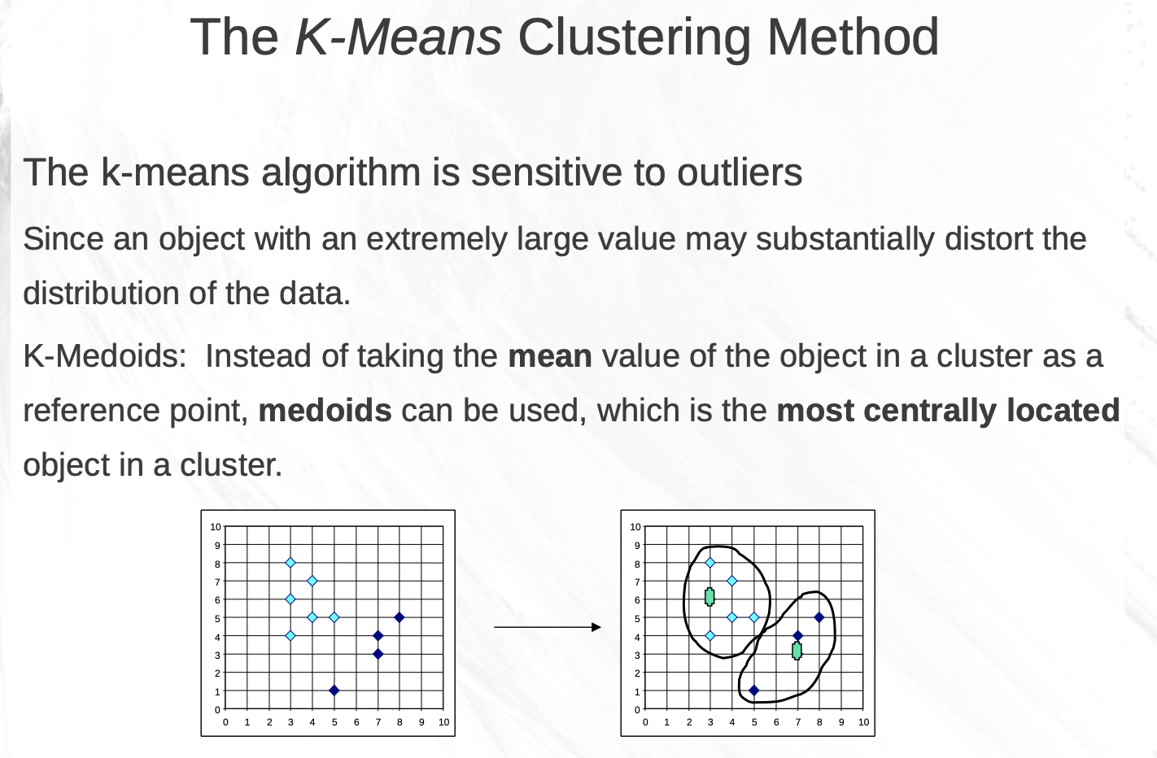
https://csc.csudh.edu/btang/seminar/slides/DBSCAN.pdf

Slide 30
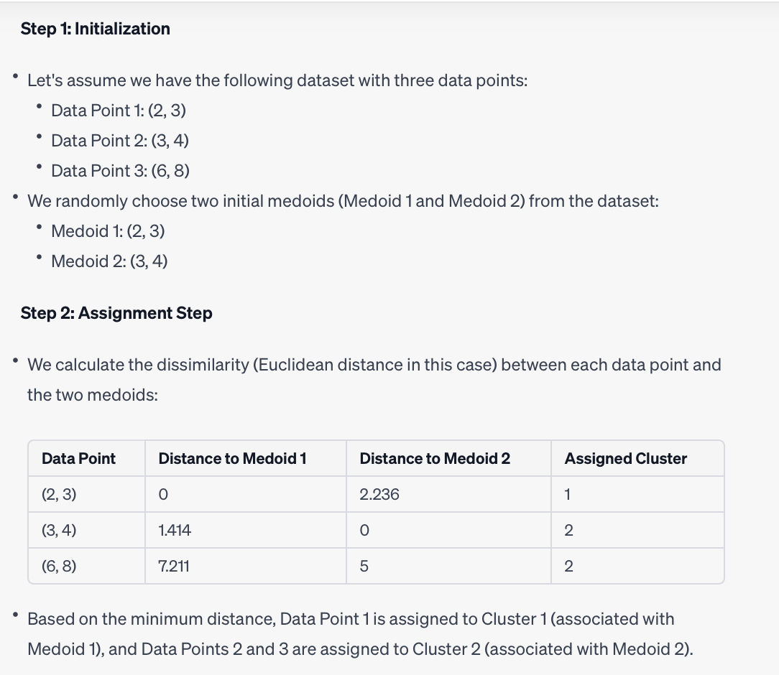

Slide 31
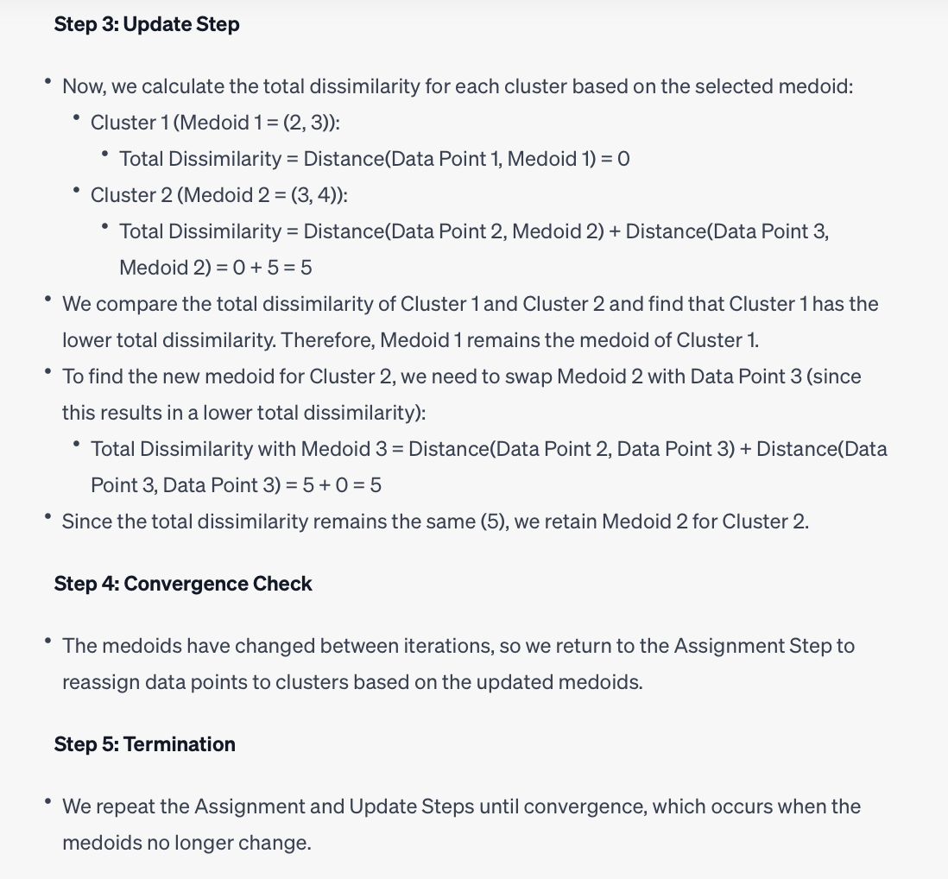

Slide 32
Strengths:
Simplicity and Speed: K-means is relatively simple to understand and easy to implement. It is computationally efficient and works well with large datasets, making it a popular choice for exploratory data analysis and quick clustering tasks.
Scalability: K-means can handle datasets with a large number of data points, making it suitable for large-scale applications.
Interpretable Results: The cluster centroids in K-means provide interpretable cluster representatives. These centroids can be analyzed to gain insights into the characteristics of each cluster.
Hard Clustering: K-means performs hard clustering, where each data point belongs to exactly one cluster. This can be beneficial when you need clear, non-overlapping assignments of data points to clusters.
Suitable for Spherical Clusters: K-means works well when the clusters are roughly spherical and have similar sizes.
Ease of Use: It is straightforward to apply and experiment with K-means, as the only required parameter is the number of clusters (K). Techniques like the elbow method can help determine a reasonable value for K.

Slide 33
Limitations:
Sensitive to Initialization: K-means is sensitive to the initial placement of cluster centroids. Different initializations can lead to different final cluster results. Techniques like K-means++ can mitigate this problem to some extent.
Dependence on K: You must specify the number of clusters (K) in advance. Choosing an inappropriate K value can result in suboptimal clusters, and determining the correct K can be challenging.
Assumption of Spherical Clusters: K-means assumes that clusters are spherical, equally sized, and isotropic, which may not be true for all datasets. It can struggle with clusters of irregular shapes and varying sizes.
Sensitivity to Outliers: Outliers can significantly affect K-means results, as they may pull the centroids away from the true cluster centers.
Limited to Numerical Data: K-means is designed for numerical data and may not work well with categorical or text data without suitable preprocessing.
Doesn't Handle Overlapping Clusters: K-means is not suitable for datasets with overlapping clusters, as it assigns each point to a single cluster.
Local Minima: K-means optimization can converge to local minima, which may lead to suboptimal solutions. Multiple initializations and running the algorithm several times can help mitigate this issue.
Objective Function Minimization: K-means minimizes the within-cluster variance, which may not always correspond to meaningful clusters, especially when clusters have complex shapes.

